Slide 1
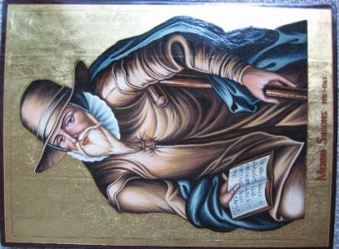
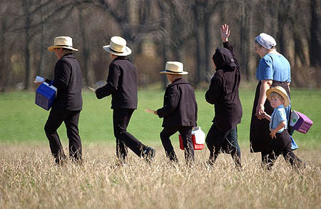
Reformation Ideas Spread
The Catholic church tried to fight the reformation
Still, it spread
Hundreds of new sects emerged
Sect – a religious group that has broken away from an established church
Anabaptists called for separation of church & state & religious toleration
Baptists, Mennonites, & Amish all come from Anabaptists

Slide 2
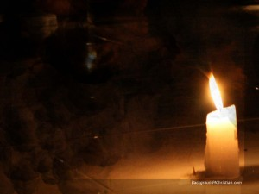
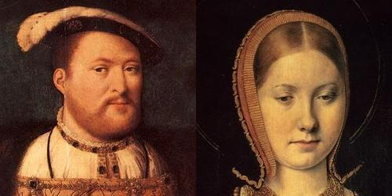
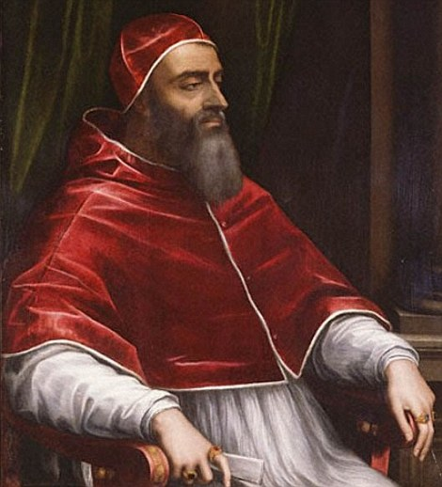
King Henry VIII of England
Originally a devout Catholic, did not like Luther’s teachings
UNTIL…..wanted to divorce 1st wife, Catherine of Aragon – in 18 years only 1 child, Mary Tudor survived
Wanted a son, so…wanted marriage annulled by Pope so he could marry Ann Boleyn
Pope wouldn’t do it

Slide 3
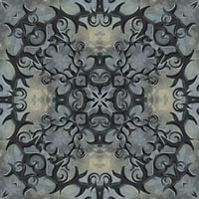
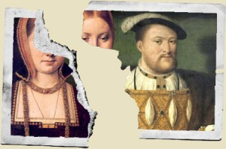
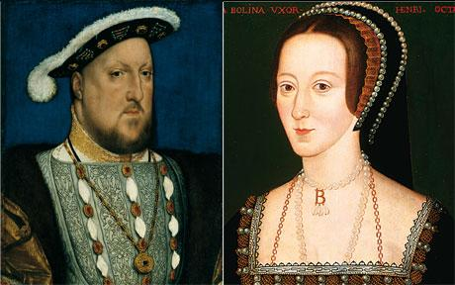
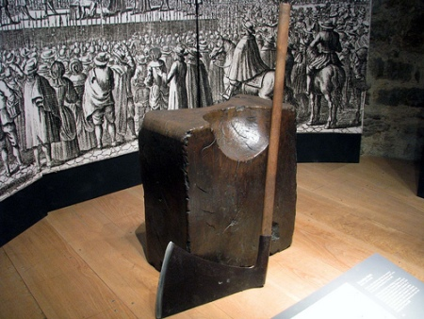
Henry took over the English Church
Took control away from the Pope
Created Church of England, “Anglican” church (it followed most Catholic forms of worship, Henry rejected most Protestant ideas)
Divorced 1st wife; married Anne Boleyn
Anne had a daughter, Elizabeth I, no sons
Found Anne guilty of “conspiracy” – chopped off her head

Slide 4
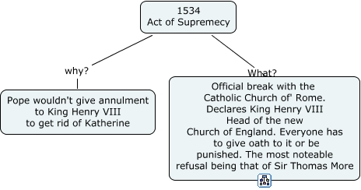
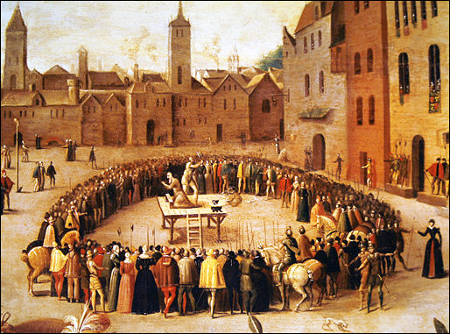
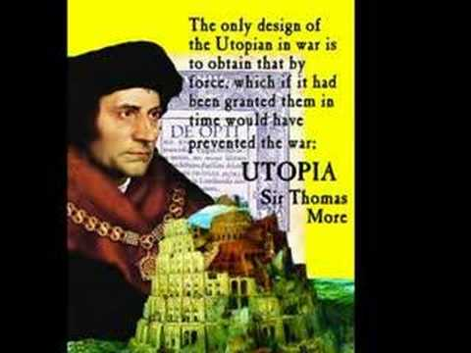
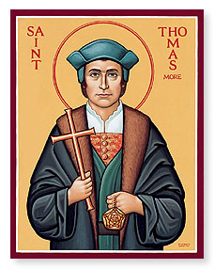
1534, Parliament passed Act of Supremacy
Made Henry supreme head of church & state
Many Catholics refused to accept, were executed – including humanist Thomas More
Seized Catholic lands & wealth
The execution of Sir Thomas More – he was later made a saint

Slide 5
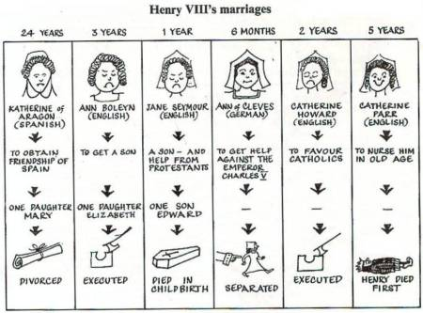
Henry married 4 more times but ended up with only one son, Edward; Henry dies Edward rules for 6 years, died in his teens
Mary Tudor (Henry’s first daughter) became queen – she was Catholic – burned Protestants at the stake
Mary dies 5 years later – Elizabeth, (Anne’s daughter) became Queen

Slide 6
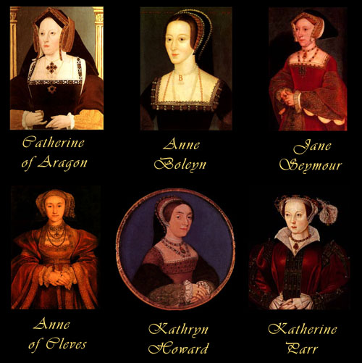
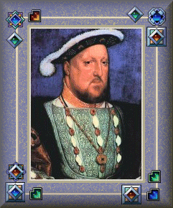
Here are portraits of Henry’s six wives

Slide 7
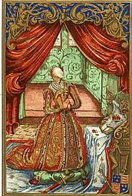
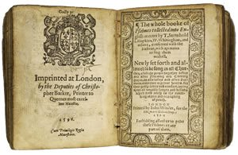
Elizabeth brought about religious reforms – called the Elizabethan Settlement
It was a compromise – acceptable middle ground
Preserved Catholic practices (used in Anglican Church, Church of England)
She was not supreme religious leader
Replaced Latin with English (vernacular) for church services
Prevented religious wars that plagued the rest of Europe

Slide 8
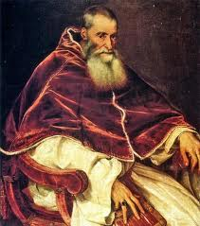
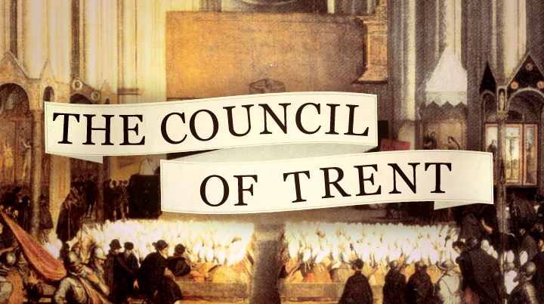
The Catholic Reformation (a.k.a. Catholic Counter-Reformation)
1530s & 1540s: Pope tries to revive authority of Church, stop Protestant Reformation
Tried ending corruption within Catholic Church
The Council of Trent (1545) - met for 20 years – decided:
Salvation comes through faith & good works
Bible is only 1 source for truth, not only source
Punishments for abuses in clergy
Empowered The Inquisition

Slide 9
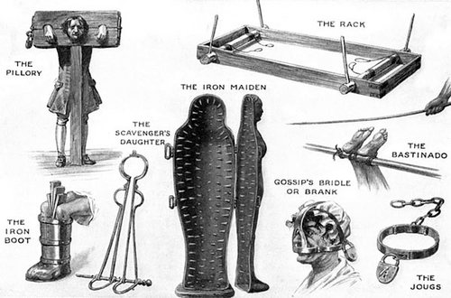
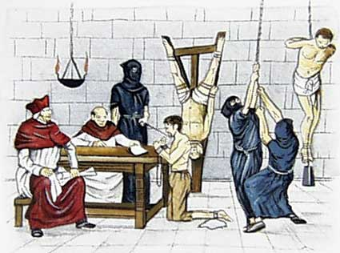
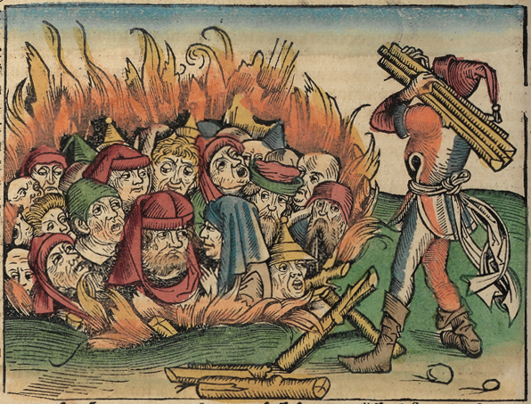
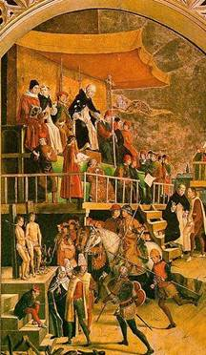
The Inquisition
Secret Church court used torture & execution for supposed heretics (many were completely innocent)
Had list of immoral & irreligious books (i.e.; Luther & Calvin, Petrarch & other humanists)

Slide 10
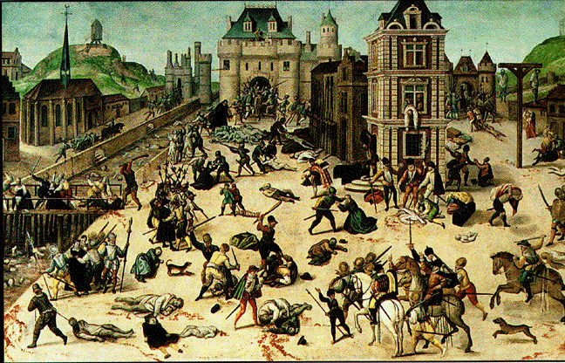
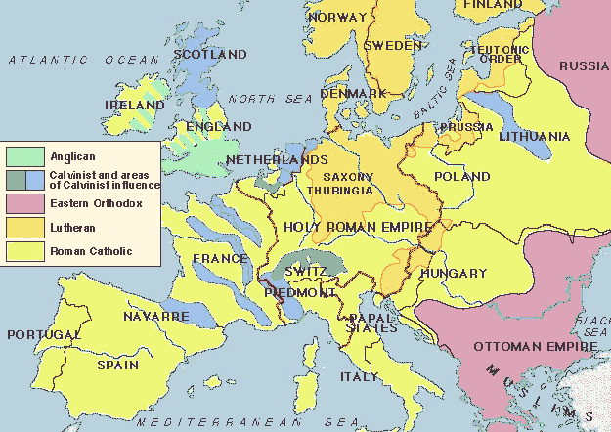
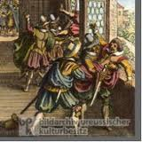
By 1600s most Europeans remained Catholic – however……
Because of continuing religious differences persecution was widespread:
Catholics against Protestants
Persecuted Jews and supposed “witches”

Slide 11
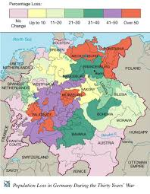
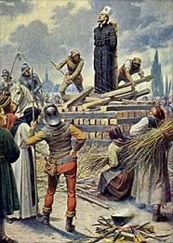
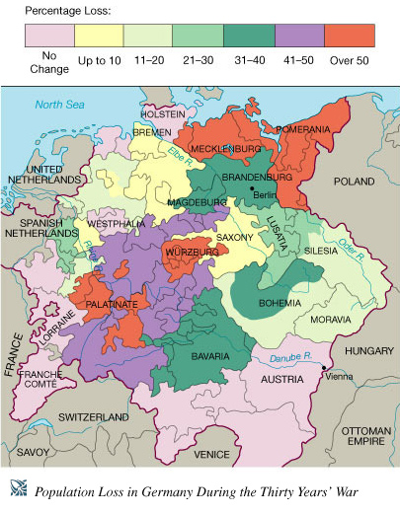
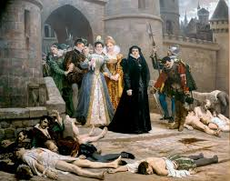
Population Loss due to Religious Wars
(including 30 Years War).

Slide 12
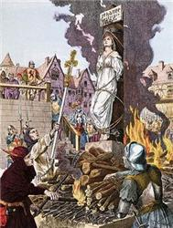
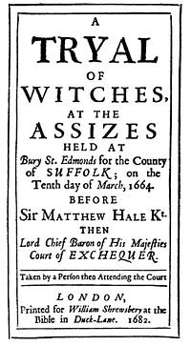
Witch Hunts
Between 1450 -1750 tens of thousands of men & women died, victims of witch hunts!!!
Most died in German states, Switzerland & France
When religious wars ended – so did witch hunts
Why were there witch hunts?
Peoples twin beliefs in Christianity & magic (ideas from Pagan days, very superstitious)
Believed people among them performed magical deeds w/help of devil – turned neighbor against neighbor – spiraled out of control
Most people accused were midwives, herbalists, healers, social outcasts & beggars – most were women

Slide 13
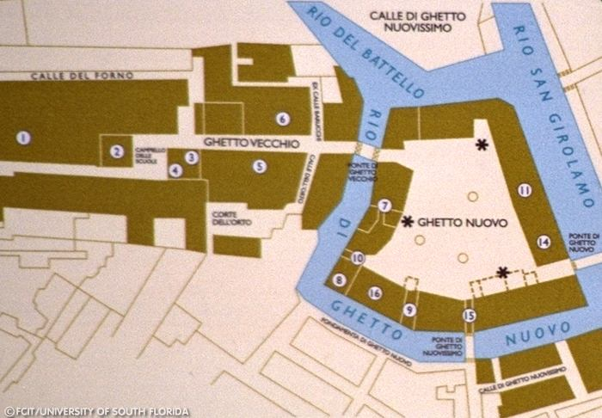
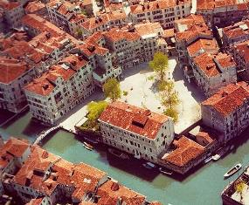
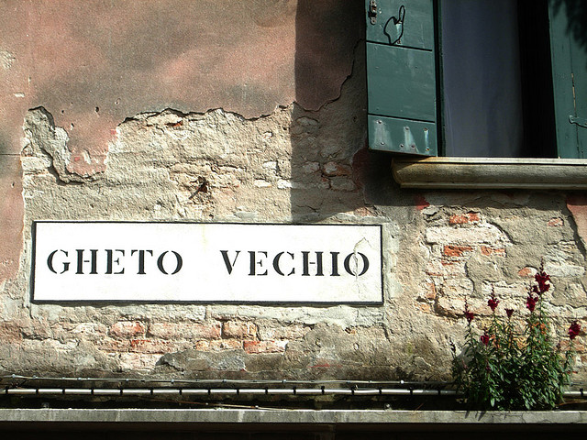
Persecuting Jews
Early Renaissance was time of prosperity for many Jews – but things quickly changed……
Spain expelled Jews in 1492, but Italy allowed them to remain
1516, Venice ordered Jews to live in separate quarter of city – called the GHETTO
Other Italian cities followed suit
The word ghetto comes from the Venetian island of Ghèto

Slide 14
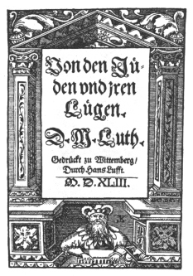
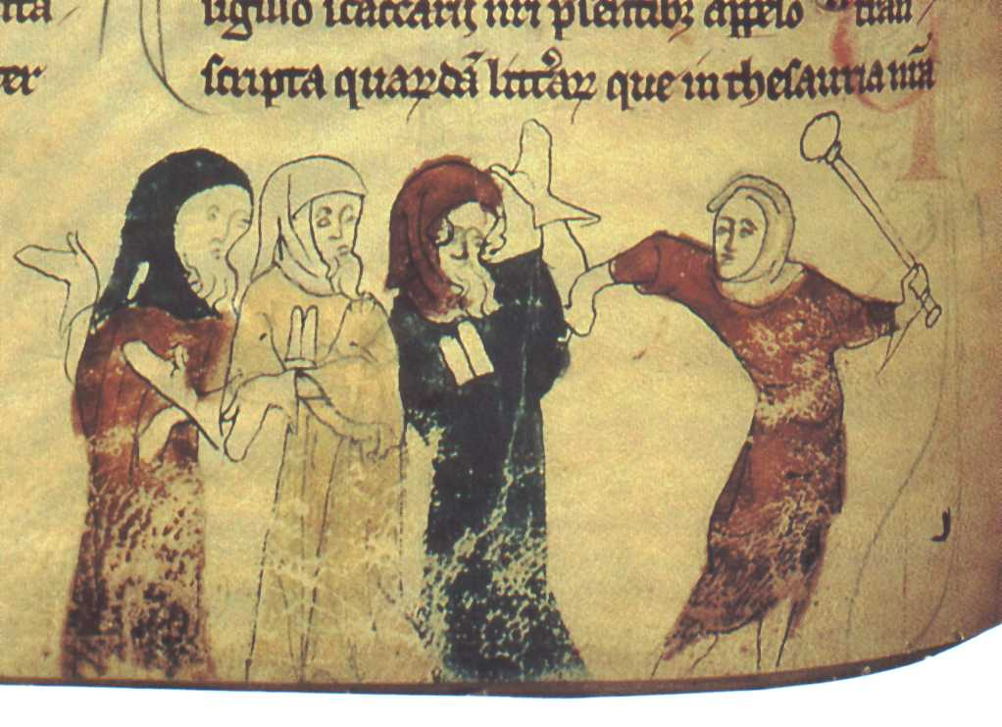
Luther’s Pamphlet – spread anti-Semitic lies & propaganda
Reformation brought more restrictions on Jews
Luther wanted them to convert – when they didn’t he had them expelled and their synagogues burned
Catholic Church also expelled & persecuted Jews
1500s many Jews migrated to the Ottoman Empire & the Netherlands to escape persecution

